Slide 1
CS 3891 Final Project
Ruida Zeng
Midterm Report
11/18/2019

Slide 2
Mid Term Goals
Finish my code bases for making API calls for the shodan and begin the testing phrase by the midterm point.

Slide 3
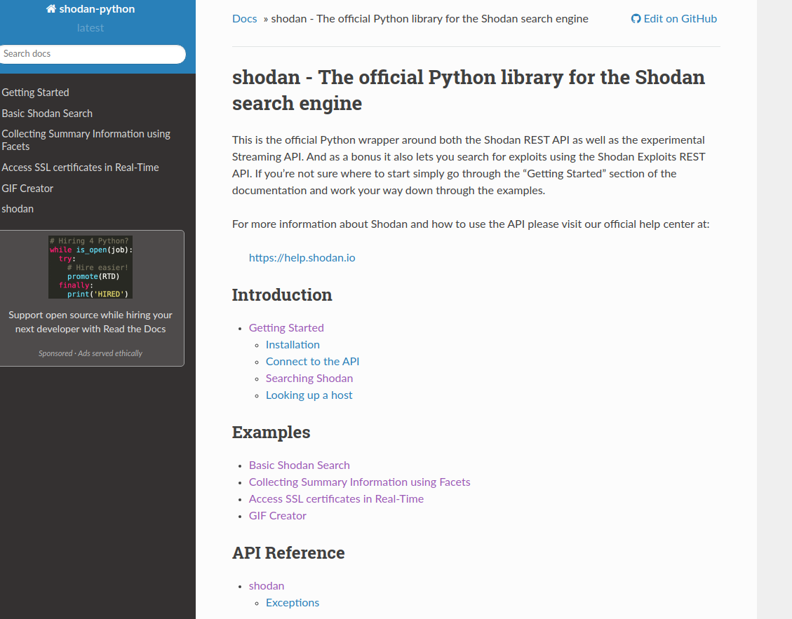
Progress
Understanding of Shodan’s API
Understanding of the nature of IP Addresses
Contacted Masood and found out that Vanderbilt has a class b address and it’s 129.59.0.0/16
Wrote code base and started making API calls to Shodan; currently in the middle of making thousands of API calls

Slide 4
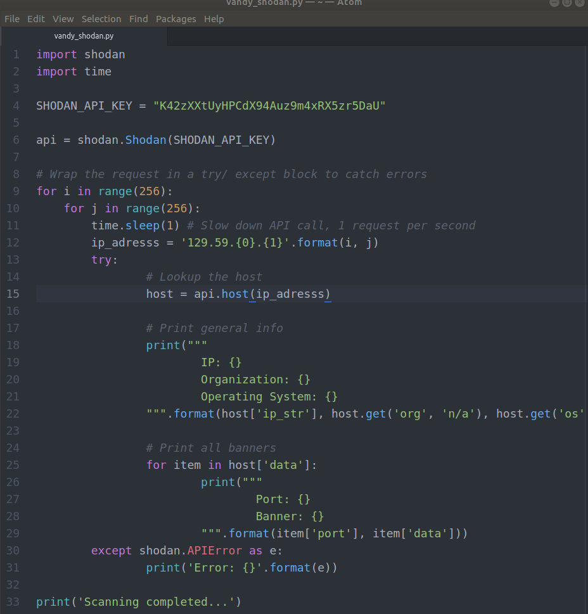
Code Base ->

Slide 5
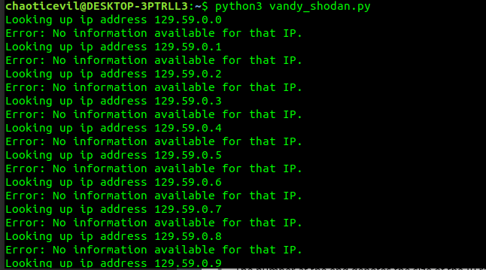

Slide 6
